Slide 1
API Testing
Charles Cao ccao@ecvictor.com
APIGM (L'association des Professionnels en Informatique du Grand Montréal)
Reference https://www.slideshare.net/kkashyap1707/api-testing-62525212

Slide 2
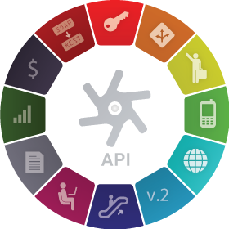
What is API？
API stands for Application Programming Interface.
API is an software to software interface, not a user interface.
With APIs, applications talk to each other without any user knowledge or intervention.
Implemented by writing function calls in the program.

Slide 3

What is API Testing？
API testing uses software to send calls to the API and get the output.
API testing treats the component under test as a black box.
The goal of API testing is to verify correct performance and error handling of the component prior to its integration into an application.

Slide 4
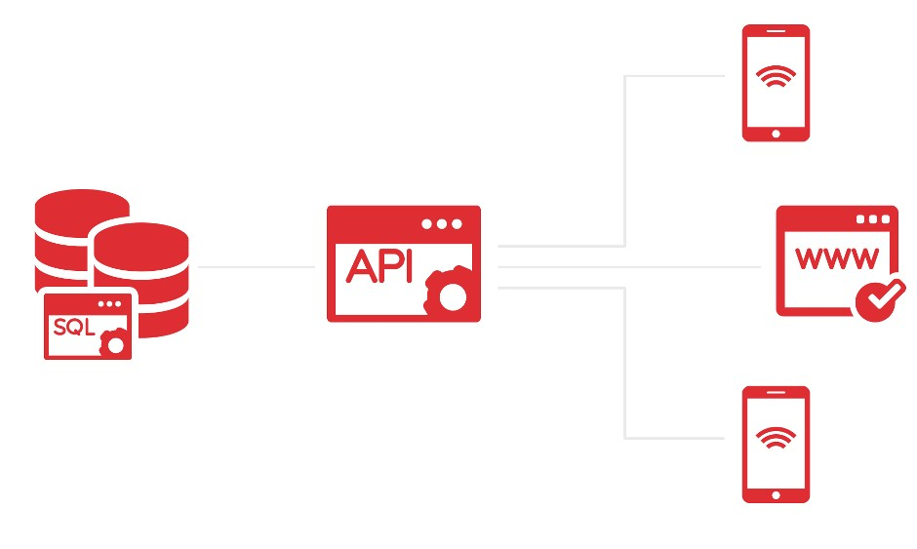
API Workflow
Response
Request
Response

Slide 5
REST API
REST – stands for Representational State Transfer.
It is a set of functions to which the developers performs requests and receive responses. In REST API interaction is made via HTTP protocol.
REST also allows computers to talk to each other over a network.
It involves using HTTP methods to send and receive messages, and does not require a strict message definition, unlike Web services.
REST messages often take the form of XML, or JavaScript Object Notation (JSON).

Slide 6
HTTP Methods
4 Commonly Used Methods:-
GET : - Provides a read only access to a resource.
POST :- Insert a new resource. Also can be used to update an existing resource.
PUT :- Insert a new resource or update if the resource already exists.
DELETE :- Used to Remove a resource.

Slide 7
HTTP Response Codes
200 OK: - Code indicates that the request was successful.
201 Created:- Code indicates that request was successful and a resource was created. It is used to confirm success of a PUT or POST request.
400 Bad Request :- It happens especially with POST and PUT requests, when the data does not pass validation, or is in the wrong format.
404 Not Found:- response indicates that the required resource could not be found.
401 Unauthorized:- error indicates that you need to perform authentication before accessing the resource.
405 Method Not Allowed:- HTTP method used is not supported for this resource.
409 Conflict:- Conflict request to create the same resource twice.
500 Internal Server Error:- Occurs due to some error on Server side.

Slide 8
Tools
Postman
https://www.getpostman.com/
Jsonview
RestAssured
Sample API
https://developer.yahoo.com/weather/

Slide 9
Common Types of Tests in API Testing
Verify if API doesn’t return any response.
Based on input request, return request should be checked.
Verification of the API whether it triggers some other event or calls another API
Verification of the API whether it is updating any data structure
Delayed in API Response time
Response Data is not structured
Difficulty in connecting and getting response from API

Slide 10
Advantages of API Testing
Advantages of API Testing:-
Time Effective
Language Independent
Test Core Functionality
Reduce Testing cost
Reduced Risks

Slide 11
Challenges of API Testing
Main challenges in API testing is Parameter Combination, Parameter Selection, and Call Sequencing
There is no GUI available to test the application which makes difficult to give input values
Parameters selection and categorization required to be known to the testers
Exception handling function needs to be tested

Slide 12
Rest aSSURED
given().
param("x", "y").
header("z", "w").
when().
get("/something").
then().
statusCode(200). body("x.y", equalTo("z"));

Slide 13
Pairwise Testing
http://www.pairwise.org/
https://www.tutorialspoint.com/software_testing_dictionary/pairwise_testing.htm

Slide 14
What is Pairwise Testing?
Pairwise Testing also known as All-pairs testing is a testing approach taken for testing the software using combinatorial method. It's a method to test all the possible discrete combinations of the parameters involved.

Slide 15
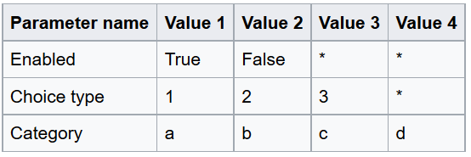
Consider the parameters shown in the table

Slide 16
'Enabled', 'Choice Type' and 'Category' have a choice range of 2, 3 and 4, respectively. An exhaustive test would involve 24 tests (2 x 3 x 4). Multiplying the two largest values (3 and 4) indicates that a pair-wise tests would involve 12 tests. The pict tool generated pairwise test cases is shown below.

Slide 17
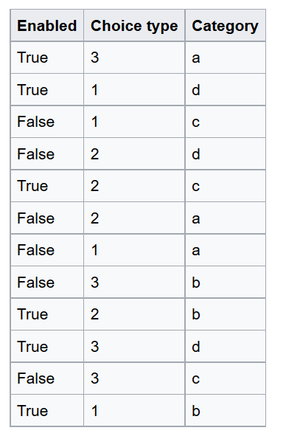
https://en.wikipedia.org/wiki/All-pairs_testing

Slide 18
Pairwise testing protects against pairwise bugs While dramatically reducing the number tests to perform,
which is especially cool because pairwise bugs represent the majority of combinatoric bugs,
And such bugs are a lot more likely to happen than ones that only happen with more variables.
the availability of tools means you no longer need to create these tests by hand.

